Slide 1
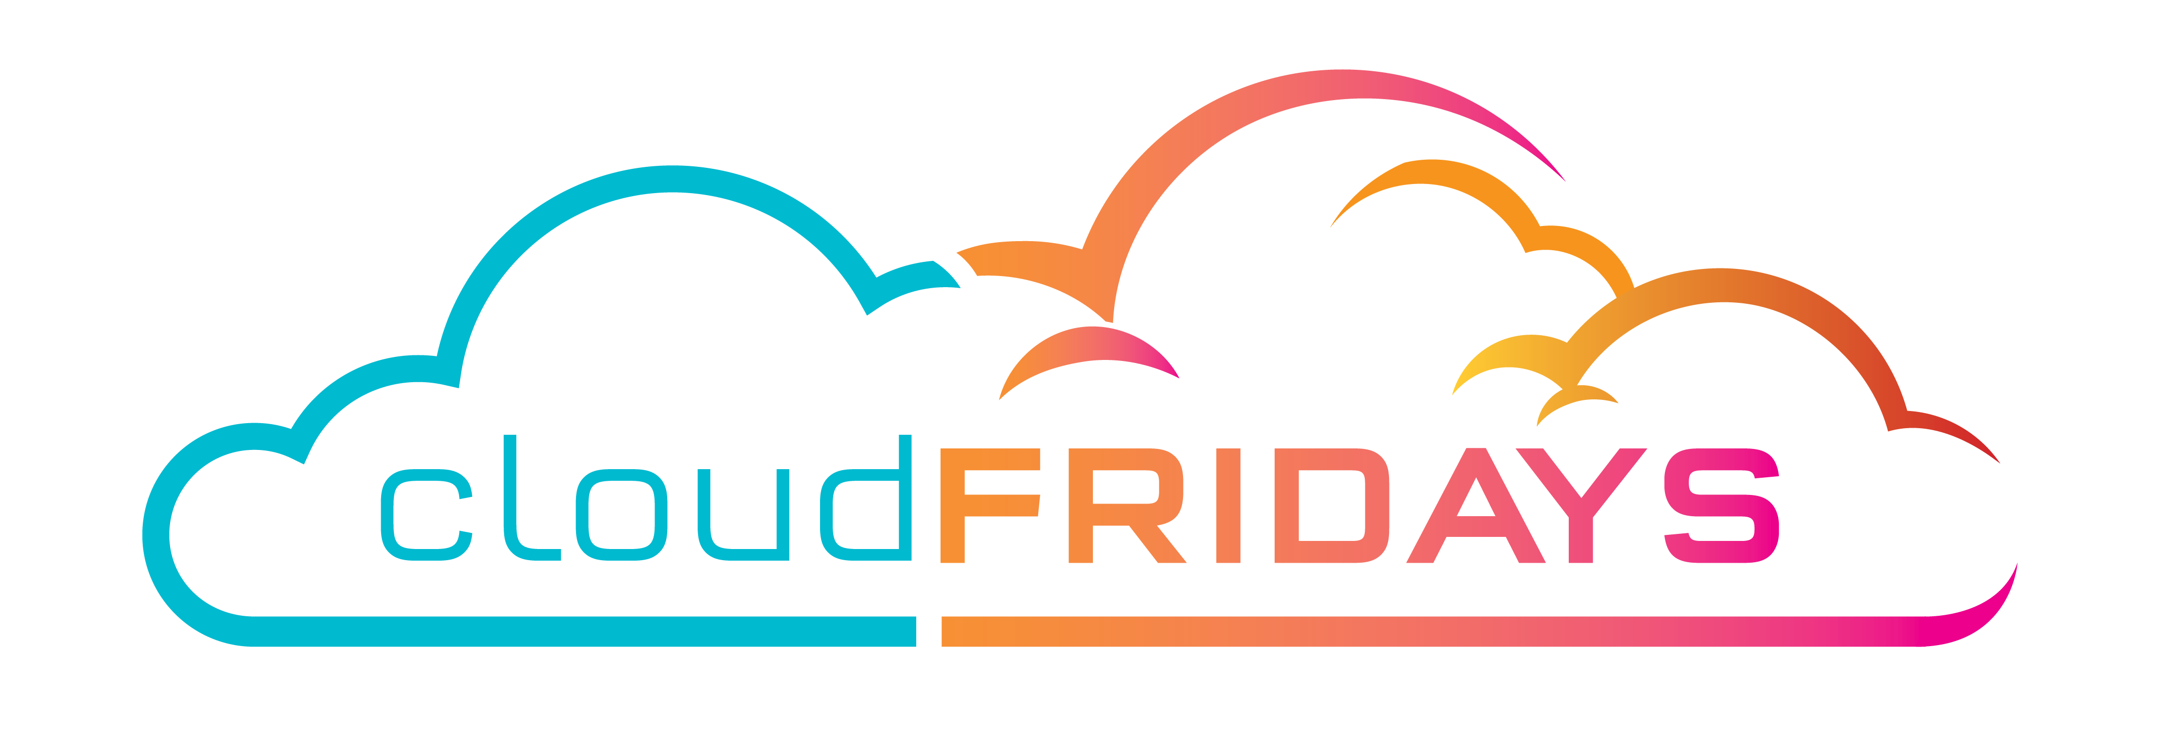

Public, Private and Hybrid
The differences between Public, Private and Hybrid cloud models
Warren du Toit & Matthew Levy
Azure MVP & Enterprise Mobility MVP

Slide 2
Agenda
Cloud definition
Public cloud
Private cloud
Hybrid cloud
Cloud model comparison
Summary

Slide 3
Cloud Definition
Service
Servers
Storage
Databases
Networking
Software
Analytics
AI
Features
HA
Scalability
Elasticity
Agility
Fault tolerance
Disaster recovery
Reach
Security

Slide 4
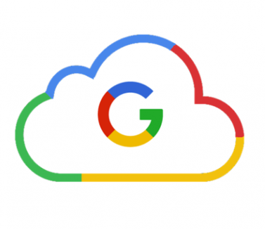

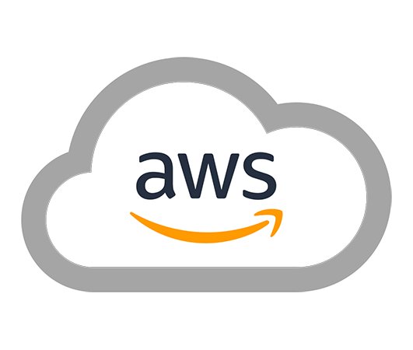
Public Clouds

Slide 5
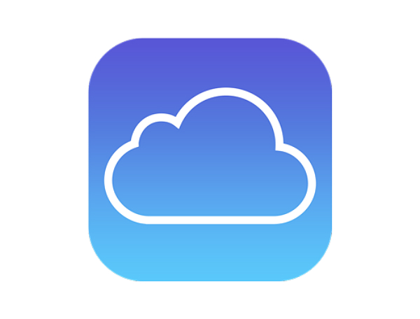


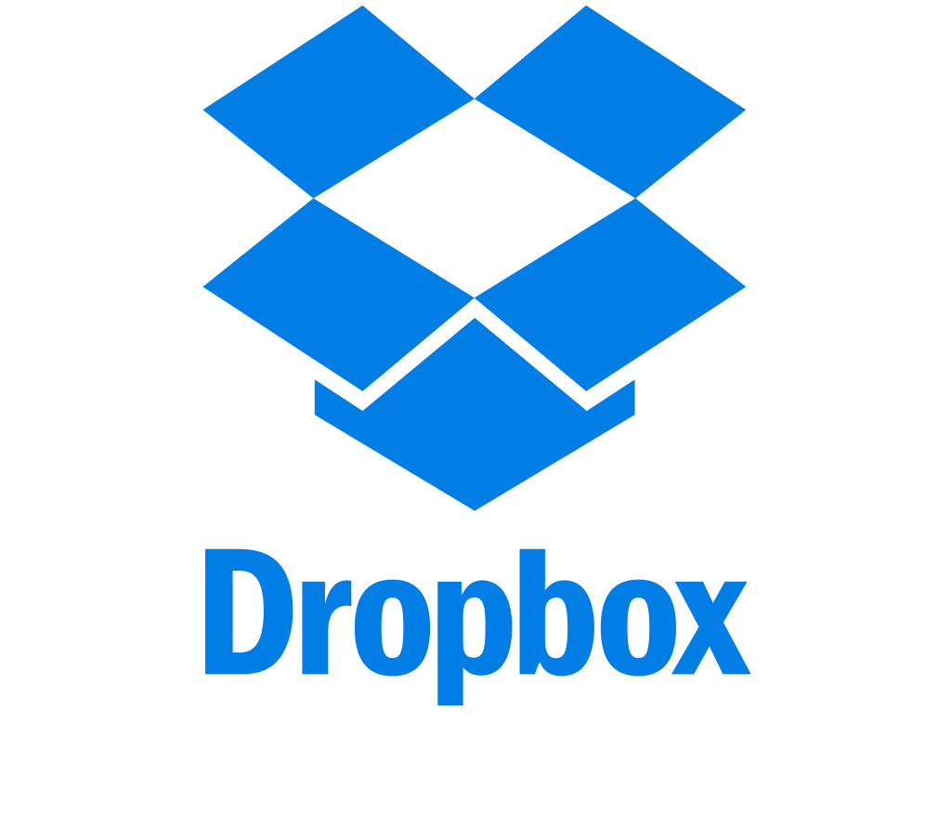

Other public clouds
Notes:
A public cloud is owned by the cloud services provider (also known as a hosting provider). It provides resources and services to multiple organizations and users, who connect to the cloud service via a secure network connection , typically over the internet.
Ownership: The resources do not belong to the organisation or user utilizing them, rather the third-party provider
Multiple End users: Available to multiple organisations or users
Public access:
Availability: Most common deployment model
Connectivity: Typically over the internet
Skills: Do not require deep technical knowledge to setup or use the services
In some cases, cloud users can save additional costs by sharing computing resources with other cloud users.
Common Use case:
Website or blog – user or organisations don’t have to worry about maintaining or managing hardware

Slide 6
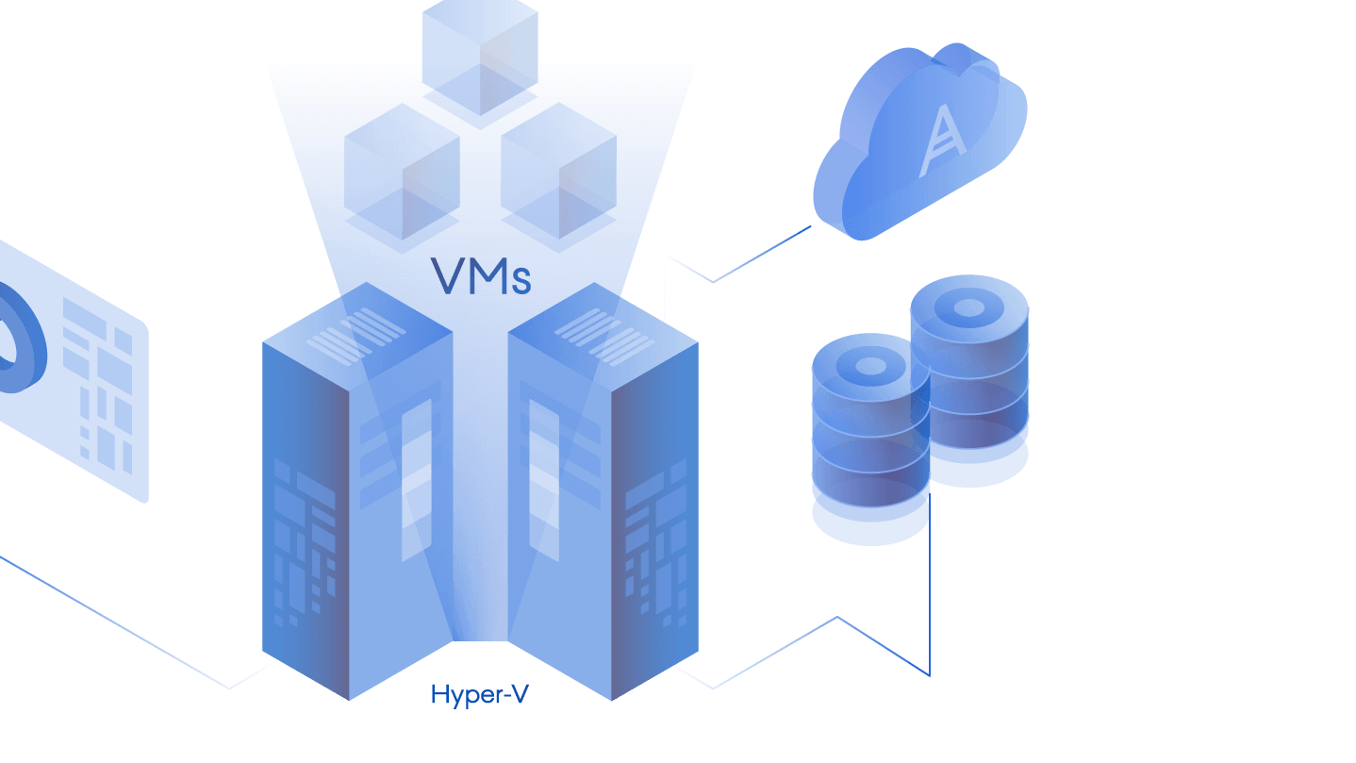
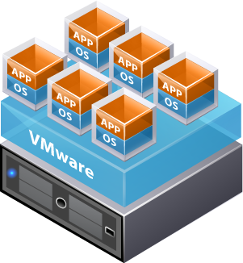
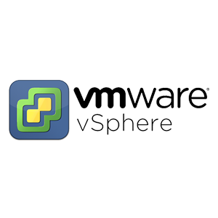
Private Cloud

